Slide 1
Revelation 16

Slide 2


Revelation 15:7 - “7 Bowls of Wrath”
⁷ And one of the four beasts gave unto the seven angels seven golden vials [bowls] full of the wrath of God, who lives for ever and ever.
#1 – Noisome and Grievous Sores
#2 – Seas Turn To Blood of Dead Man
#3 – Rivers and Fountains Became Blood
#4 – Scorch Men With Fire
#5 – Beast’s Kingdom Filled with Darkness
#6 – Euphrates Dried Up; Kings of East
#7 – Great Voice From Temple “It Is Done”
(16:2)
(16:3)
(16:4)
(16:8)
(16:10)
(16:12)
(16:17)
Notes:
Angel 4 (verse 9)
Angel 5 (verse 11)
Angel 7 (verse 21)
Evil blasphemed God for judgment
Angel 4 (verse 9)
Angel 5 (verse 11)
Evil repented not
Remember: #3 – Rivers and fountains became blood

Slide 3
Revelation 16:5-7
⁵ And I heard the angel of the waters say, You art righteous, O Lord, which are, and was, and shalt be, because You have judged thus.
Why is judgment of villain of Revelation occurring?
⁶ For they have shed the blood of saints and prophets, and You have given them blood to drink; for they are worthy.
⁷ And I heard another out of the altar say, Even so, Lord God Almighty, true and righteous are Your judgments.
Notes:
#3 – Rivers and Fountains Became Blood (verse 4)
Prophets – not necessarily “tellers of the future”.
Prophesy also means:
“The telling of a divine will and purpose that can only be known through divine inspiration.”
100% consistent with definition of the Tribulation in chapters 1, 6, 7, 19, and 20.

Slide 4
Revelation 16:9-11
⁹ And men were scorched with great heat, and blasphemed the name of God, which hath power over these plagues: and they repented not to give him glory.
¹⁰ And the fifth angel poured out his vial [bowl] upon the seat [throne] of the beast; and his kingdom was full of darkness; and they gnawed their tongues for pain.
¹¹ And blasphemed the God of heaven because of their pains and their sores, and repented not of their deeds.
3 verses
  Twice mentions not repenting
God still trying to get repentance this late in Revelation
  Bowls 1 - 5
Notes:
Twice in Rev 16, God gave villain opportunity to repent, and they refused to.
If God is this patient with those against God, how much more patient is he with us who try to walk in the light.
Very much like people today.
“They” – plurality of villains in Revelation

Slide 5
Revelation 16:12
¹² And the sixth angel poured out his vial [bowl] upon the great river Euphrates; and the water thereof was dried up, that the way of the kings of the east might be prepared.
“Kings of the East”
Hebrews’ enemies always came from East, Northeast
  Persian Empire
  Assyrian Empire
  Babylonian Empire
God used “kings of the east” to punish Israel
“East” always associated with enemies of God’s people
Notes:
Kings of the East are making their way to do battle with God.
Final reckoning is referred to as “Armageddon”.
If literal:
This event happens in the future
How does that comfort the 7 churches of Asia?
If figurative/symbolic:
God has had enough
God will put an end to this

Slide 6
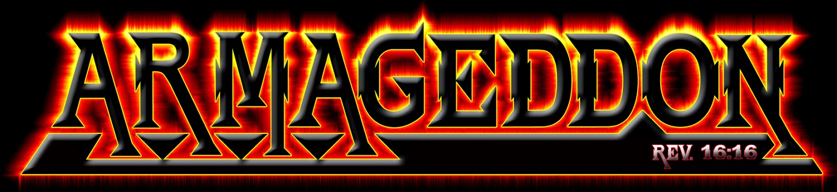

Slide 7
Revelation 16:13-14
¹³ And I saw three unclean spirits that looked like frogs coming out of the mouths of the dragon, the beast, and the false prophet.
¹⁴ For they are the spirits of devils, working miracles, which go forth unto the kings of the earth and of the whole world, to gather them to the battle of that great day of God Almighty.
¹⁶ And he gathered them together into a place called in the Hebrew tongue Armageddon.
What is Armageddon?
Notes:
Literal or figurative battle?
Is God going to actually come down to earth, gather an army, and fight against Revelation’s villain and his armies?
If God wants to defeat an army, he only has to speak.
If God wants to defeat a nation, he only has to speak.
If God wants to judge evil, he only has to speak.
Who are the kings of the East?
United Nations
Fairly good answer
4 of members are Russia, China, India, and Japan!

Slide 8
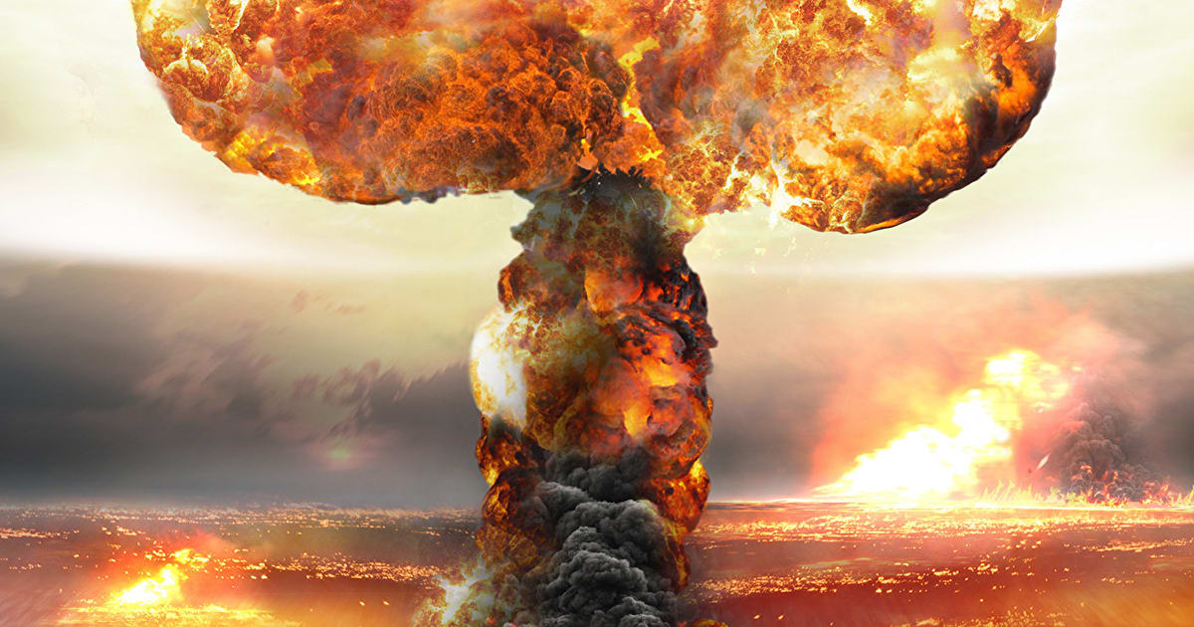
What is Armageddon?
Nuclear war - US and Russia?
Notes:
Discussion on internet concerning Pre-M’s interpretation of Russia and China strengthening their cooperative efforts.

Slide 9
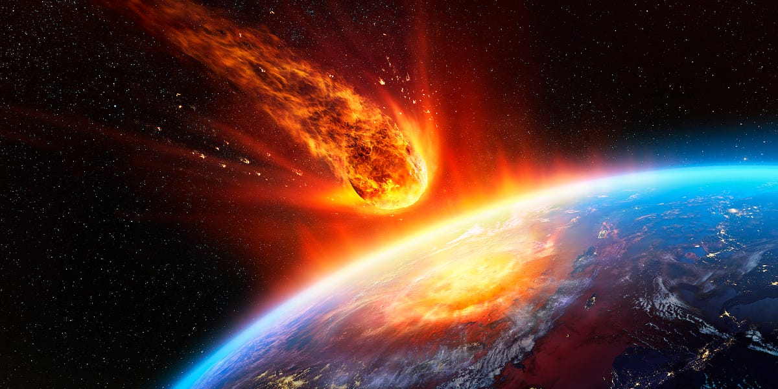
What is Armageddon?
Asteroid destroying earth?

Slide 10
Revelation 16:13-14
¹³ And I saw three unclean spirits that looked like frogs coming out of the mouths of the dragon, the beast, and the false prophet.
¹⁴ For they are the spirits of devils, working miracles, which go forth unto the kings of the earth and of the whole world, to gather them to the battle of that great day of God Almighty.
¹⁶ And he gathered them together into a place called in the Hebrew tongue Armageddon.
Premillennialists: “Armageddon”
Armageddon = end of world
  Villain gathers accomplices to “battle” God
  Russia/China/India/N. Korea offensive against Israel
  Causes Jesus to return to earth to set up kingdom
  Ushers in the 1000 Year Reign
Notes:
Literal or figurative battle?
Is God going to actually come down to earth, gather an army, and fight against Revelation’s villain and his armies?
If God wants to defeat an army, he only has to speak.
If God wants to defeat a nation, he only has to speak.
If God wants to judge evil, he only has to speak.
Who are the kings of the East?
United Nations
Fairly good answer
4 of members are Russia, China, India, and Japan!

Slide 11
“March Toward Armageddon”
“March Toward Armageddon”
https://www.thetrumpet.com/568-march-toward-armageddon
Armageddon
In the near future, a culturally and religiously diverse Asia will ignore its differences, celebrate its similarities and join economically and militarily to form the most gargantuan army in history. Challenged by the European powers to its west, it will strike back with the most devastating force ever unleashed on one entity - ultimately annihilating that church-state union once and for all.
This will lead to the march to Armageddon. The blast of the seventh trumpet angel announces the return of Jesus Christ, coming just in time to save mankind from nuclear annihilation (Matt. 24:22) and to take the reins of rulership on Earth (Rev. 11:15). Of course, unrepentant mankind will not be happy about this (Rev. 11:18). The nations will be so angry toward Christ, in fact, that what is left of the beast power and the kings of the east will form an alliance of their own - a reaction to the greatest power and army of the universe, God’s army - to fight the coming King of
Notes:
Immediately before this section of the article, this was written:
“Watch for greater collusion between the Asian giants: Russia, China, India and Japan.
Finally, of course, there are the developing relations between Russia and China, perhaps more visible than any other bilateral relations discussed to this point. Watch this situation as well (as expounded in our booklet Russia and China in Prophecy).”

Slide 12
“March Toward Armageddon”
“March Toward Armageddon”
(continued)
kings! This is when the river Euphrates will be dried up, to prepare the way for the kings of the east to gather in this valley just northwest of Jerusalem.
This 3½ year war will conclude with Christ utterly wiping out man’s futile efforts to maintain control of the world (Zech. 14:12), at which time Christ will set up His perfect, peace-producing, world-encompassing government.
- https://www.thetrumpet.com/568-march-toward-armageddon
Why would it take God’s army 3 ½ years to win the victory? Is God that weak?
Where in Ch. 16 is there mention of a war lasting 3 ½ years?
Where is ‘world dominance’ mentioned in Ch. 16?
Notes:
His perfect, peace-producing, world-encompassing government
= 1000 Year Reign
Why would it take God’s army 3 ½ years to win the victory? Is he that weak?
Where in Ch. 16 is there mention of a war lasting 3 ½ years?
Where is ‘world dominance’ mentioned in Ch. 16?

Slide 13
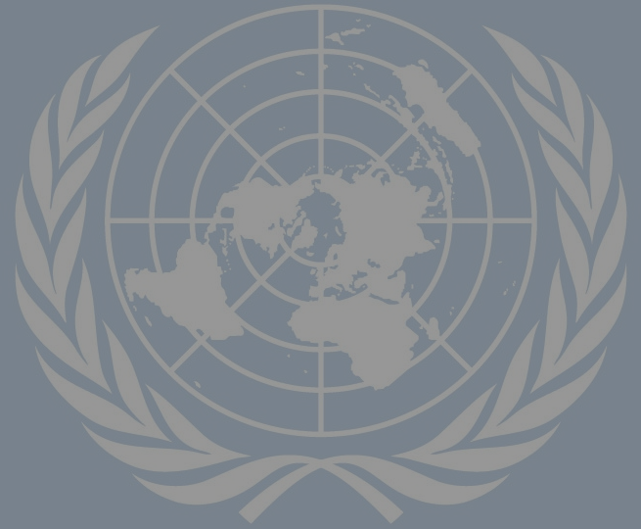
“United Nations: Fast Track to Armageddon”
“Road Map To Armageddon”
“In pushing Israel along a “road map” toward a Palestinian state, the nations of the world defy God. . . The false peace that may soon be established is, in fact, a “road map” to Armageddon.”
https://israelmyglory.org/article/road-map-to-armageddon/
U.N. “fast tracking us” to Armageddon
  Through biased votes against Israel
  Through forcing Israel to become a Palestinian state
  Through US weakness in supporting Israel

Slide 14
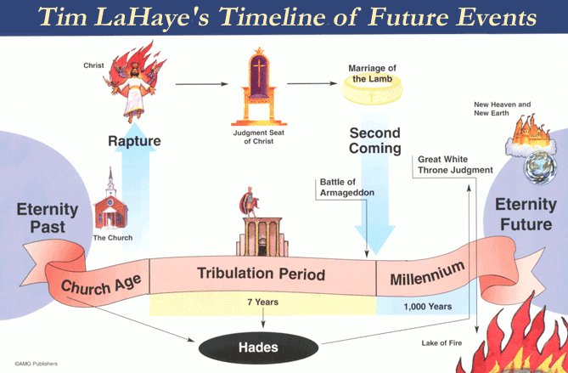
Notes:
Pre-M claim “Second Coming” occurs after and because of Armageddon.
“Anti-Christ” will appear and lead an invasion against Israel.
This would imply that the Anti-Christ is the Russian leader?

Slide 15
Revelation 16:16
¹⁶ And he gathered them together into a place called in the Hebrew tongue Armageddon.
What is “Armageddon”
Hebrew: “Har Megedon” ¹
Means: “Hill / Mount of Megiddo”
Verse 16: “Place”
¹ https://biblehub.com/hebrew/2022.htm
https://www.internationalstandardbible.com/H/har-magedon.html
Notes:
What is Armageddon?

Slide 16
Revelation: 4 Names
1. Plains (valley) of Megiddo
  Mount / Hill of Megiddo
  2 Chronicles 35:22
2. Jezreel Valley
  Hebrew name
  Joshua 17:16 , Judges 6:33
3. Valley / Plain of Esdraelon
  Greek for Jezreel
4. Taanach
  Town near Megiddo
  Judges 5:19
Notes:
Josephus references this area as the “Great Plain”.
> Josephus, De Bello Judaico (Wars of the Jews III, 48 (Wars of the Jews 3.3.4, Vita §, 41, et al.)

Slide 17
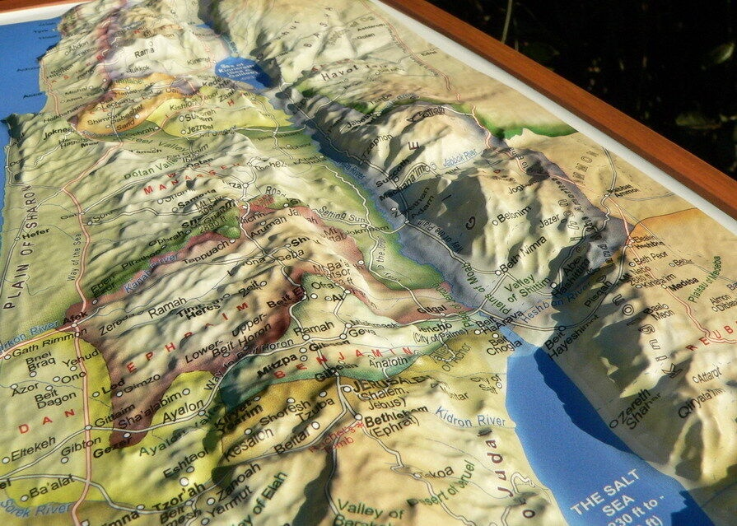
Jezreel Valley
(Plains of Megiddo)
Sea of Galilee
Jordan River
Dead Sea
Jerusalem
Bethlehem

Slide 18
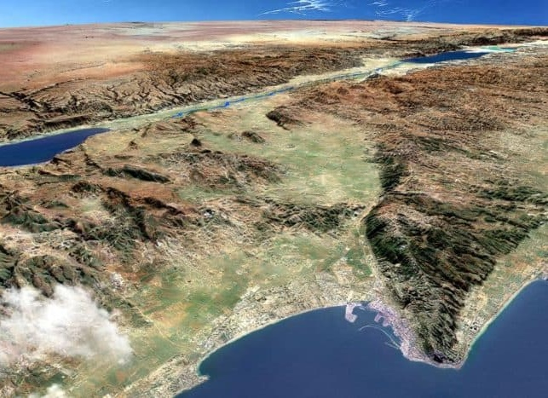
Dead Sea
Jordan River
Jerusalem
Sea of Galilee
Jezreel
Endor
Megiddo Fortress
Nazareth
Mount Carmel
Jezreel Valley
(Plains of Megiddo)
© Stephen M. Miller
Casual English Bible
CasualEnglishBible.com
Notes:
Each side of the valley is approx. 20 miles across
Approx. 96 square miles

Slide 19
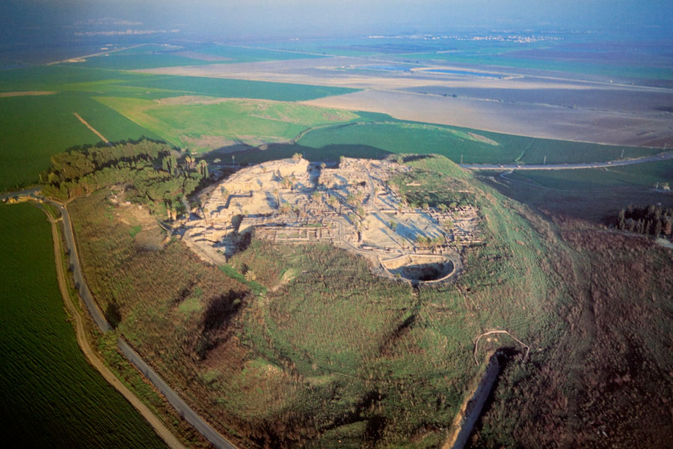
Megiddo Fortress Overlooking Jezreel Valley

Slide 20
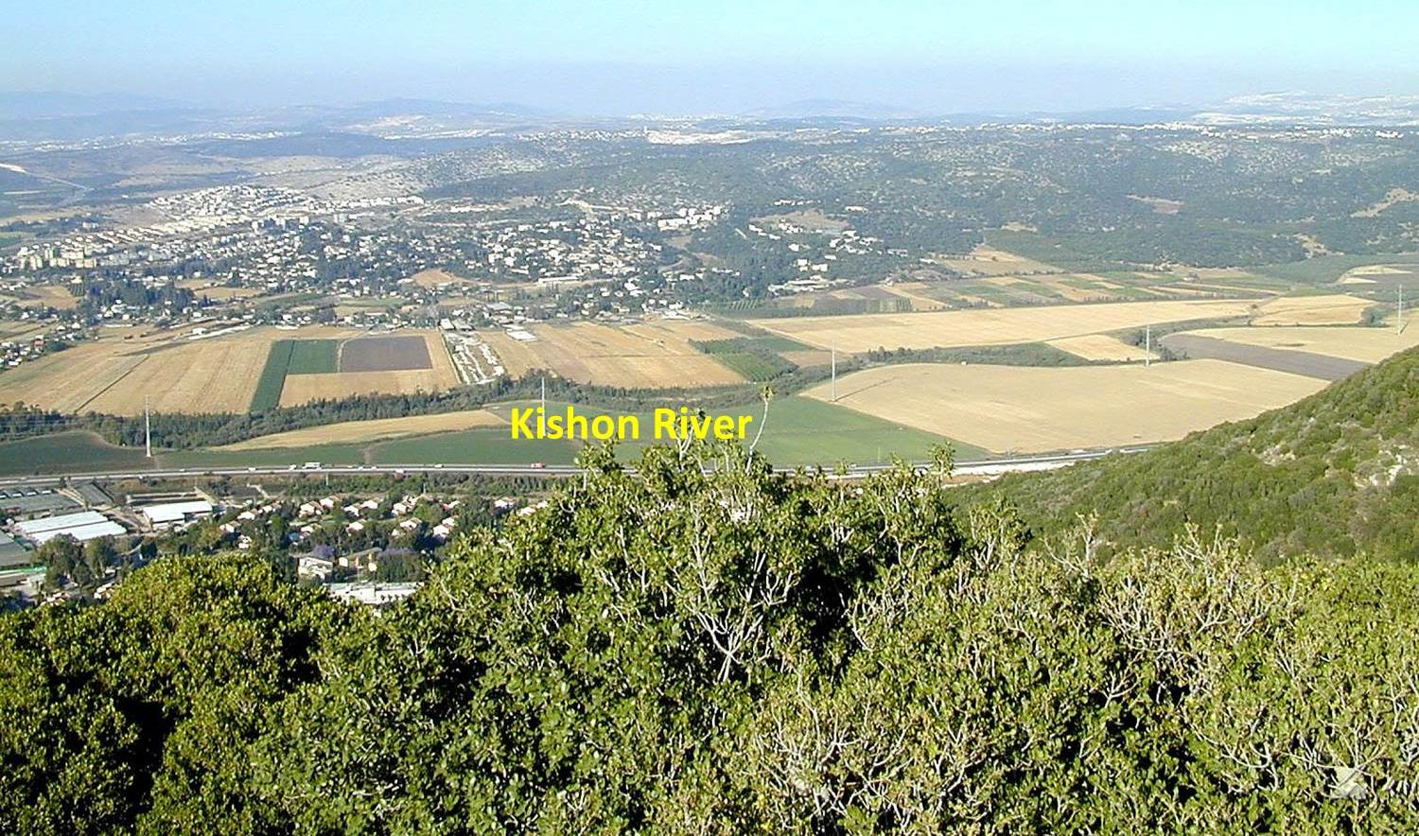
Mount Carmel Overlooking Jezreel Valley
Notes:
1 Kings 18:40 names the Kishon River as the site where the prophets of Baal were executed on Elijah's orders, following Elijah's contest with the prophets of Baal nearby on Mount Carmel (1 Kings 18:20–39).

Slide 21
Revelation 16: Battles of Megiddo
Joshua 12:21
Joshua 17:11
Judges 1:27
Judges 4
Judges 5:19
Judges 6:33
Judges 7
1 Sam 29:1
1 Sam 31:1
1 Kings 4:12
1 Kings 9:15-19
2 Kings 9:27
2 Kings 23:29-30
1 Chronicles 7:29
2 Chronicles 35:20-25
Egyptians Germans
Canaanites Arabs
Midianites Israelis
Amalekites
Philistines
Hasmonaeans
Greeks
Romans
Muslims
Crusaders
Mamelukes
Mongols
French
Ottomans
British
Notes:
Armies came here to settle their differences so as not to destroy their home cities.
“David and Bathsheba”
“David should have been at war”
David should have been on the battlefield
Could that battlefield possibly have been Plains/Valley of Megiddo?
Cline, an archaeologist at the University of Cincinnati, who has excavated at Megiddo, counted 34 battles fought at the city or its surrounding valley. About a dozen of the battlesf occurred in biblical times.

Slide 22
Revelation 16: End of the World?
¹⁶ And he gathered them together into a place called in the Hebrew tongue Armageddon.
Revelation says:
  Armageddon is a place
  A place where differences are settled
Chapter 18
  Villains’ accomplices respond to judgment
  Still alive on earth after Armageddon
Armageddon vs. 1000 Year Reign
  Armageddon = end of the world in chapter 16?
  1000 Year Reign occurs on same earth in chapter 20?
Notes:
Studying chapters 17-19 will make it very apparent why Armageddon is not the “end of the world”
If Armageddon is the end of the world, then where is the 1000 Year Reign in chapter 20 supposed to occur?
Physical often used to:
Describe the spiritual
Explain the spiritual

